Slide 1
Meditation & Manifestation Workshop
Erin Nicole Scherer
The Creative’s Workday
January 12, 2019

Slide 2
Agenda
Introduction
Manifestation
Scarcity vs Abundance Mindset
What energy is in store for 2019?
Journaling Activities
Creating a Meditation Practice
Using the Moon to Set Your Intentions
Guided Meditation

Slide 3
Hi! I’m Erin
Wellness advocate, social media and communications specialist, moon circle facilitator.
Passion for understanding our connection to the universe, spending time in nature, practicing yoga, and exploring our beautiful home, Mother Earth.
Traveled throughout North America, Europe, Australia, South America and Asia.
Renewed focus on learning how to raise my consciousness and helping others connect to the energy of the universe through yoga, meditation and nature.

Slide 4
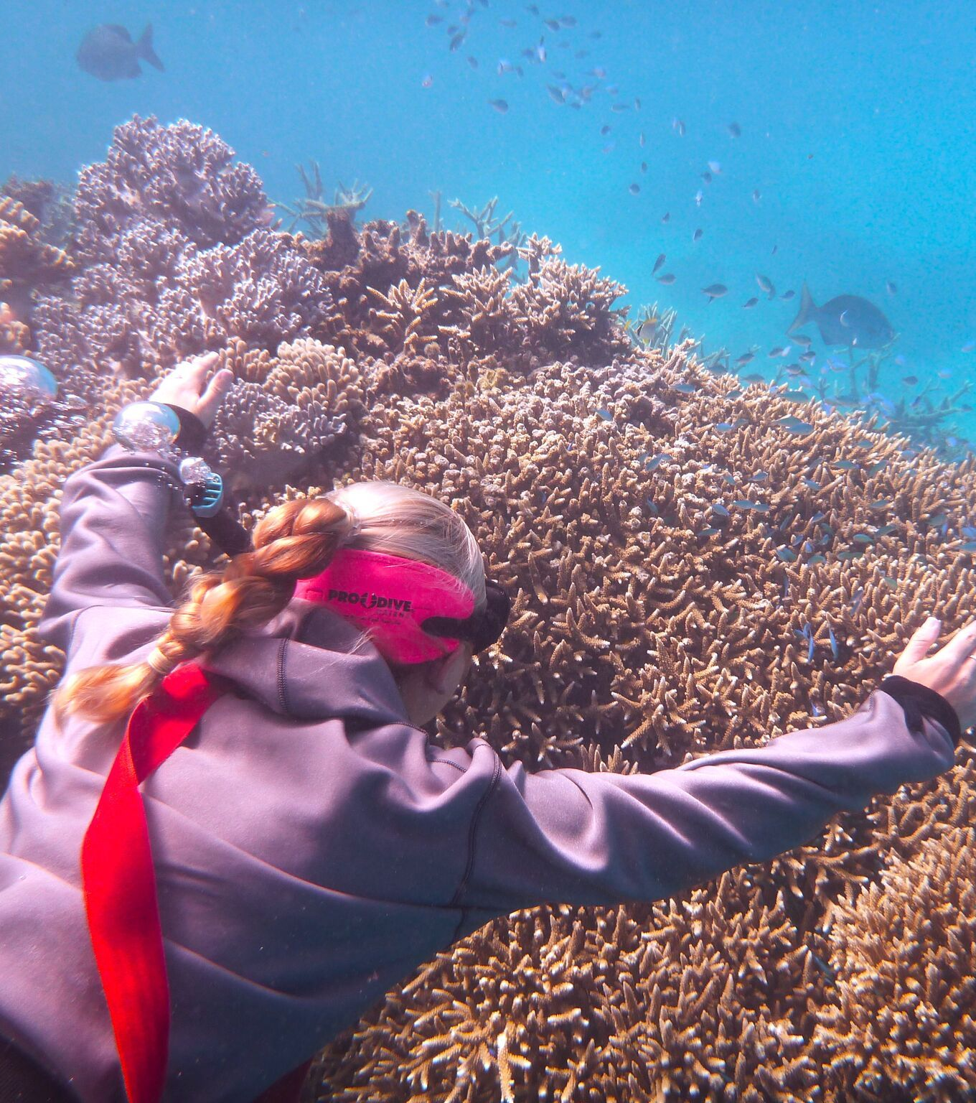
Our Connection to the Universe
Our society is entering a new age
Feminine vs. masculine
Ethical companies vs Profit-focused
We are all connected, rekindling our love and respect for mother earth and the universe as a whole
We can use nature to help guide us in all aspects of our lives – including our careers

Slide 5
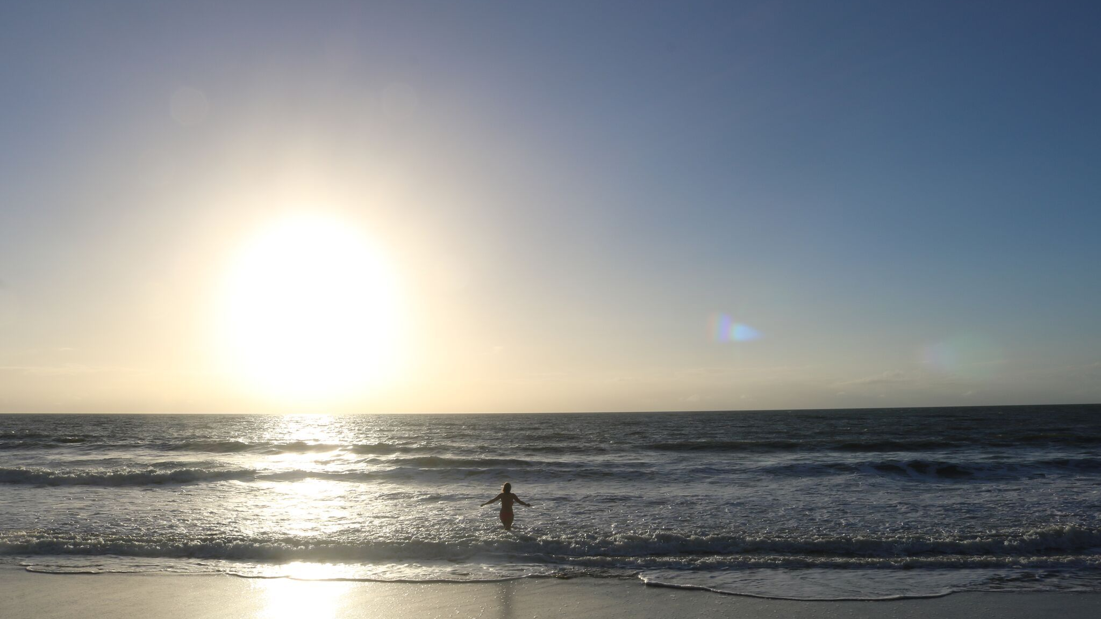
MANIFESTATION

Slide 6
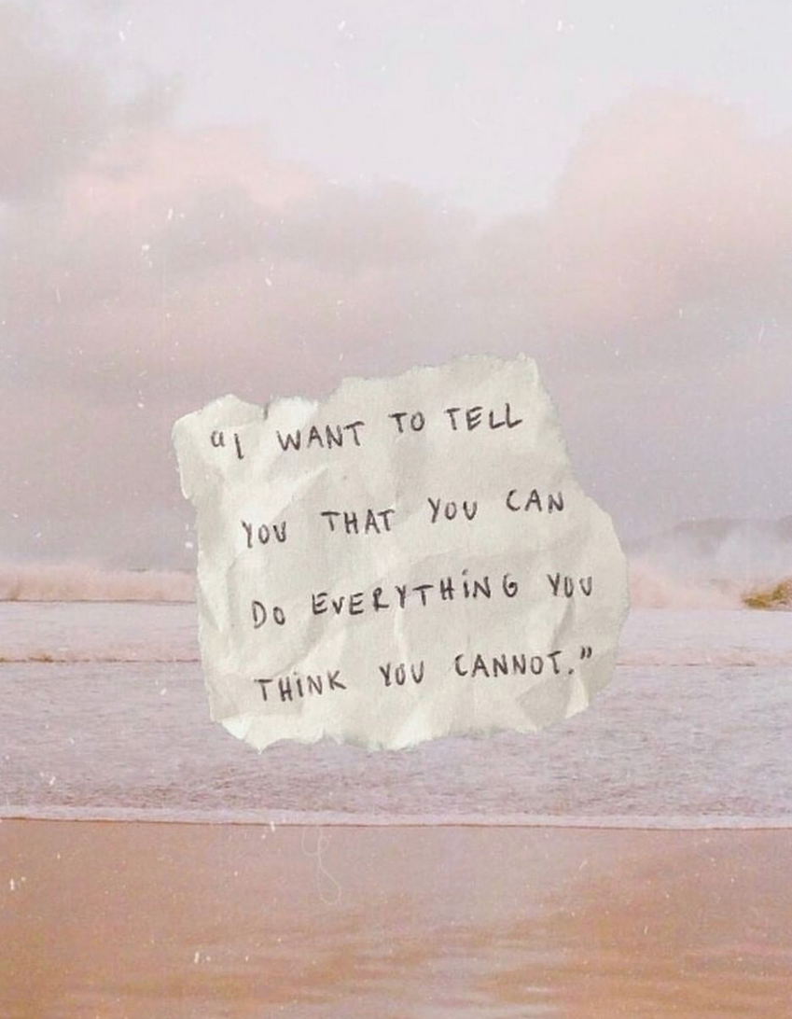
What is Manifestation?
Something you bring forth in your physical life through your thoughts, feelings, or beliefs
We are divine beings having a human experience – you’re more magical than you think
“Spelling” = spells. Our words have power, our thoughts are tangible. Everything has it’s own energy and like attracts like.
You frame the world you live in. It’s time to manifest a life you want & deserve

Slide 7
Scarcity Mindset
Does this sound familiar?
I don’t have enough time to: ___________________________
I don’t have enough money to: ___________________________
I don’t have the skills to: ___________________________
I don’t have enough energy to: ___________________________

Slide 8
Abundance Mindset
“I believe that this Nation should commit itself to achieving the goal, before this decade is out, of landing a man on the moon and returning him safely to earth.”
JFK worked from an abundance mindset. Before NASA even knew if it was possible, JFK made a commitment to the nation to land a man on the moon. And it happened.

Slide 9
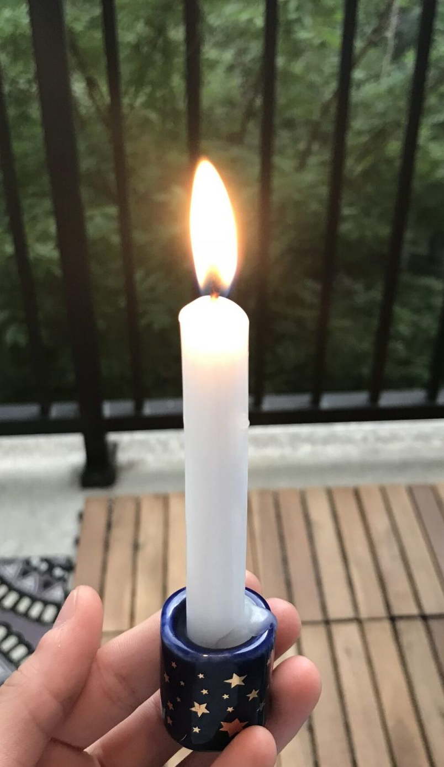
Abundance Mindset
You don’t need to know how you’re going to do “it” yet, you just need to get clear on what you want
If you don’t know what you want, decide how you want to feel in 2019 and focus on that first
This doesn’t mean you won’t fail, but it allows you the opportunity to move beyond your doubts and continue finding ways to make your dreams a reality.
And remember, the universe has your back

Slide 10
Manifesting Abundance
It starts with an attitude of gratitude
Write a list of all the things you are grateful for right now
What are you most proud of from 2018?
What have you ALREADY accomplished?

Slide 12
Energy of a Number Three Year
3
Creative – Create vs Consume
Three is associated with Jupiter
Jupiter is known to be associated with luck, expansion and leaps of faith
What do you want to bring to life from deep within your soul? You have access to this in 2019
Take a leap of faith and know luck is on your side
Inner child – tap into that playful curiosity

Slide 13
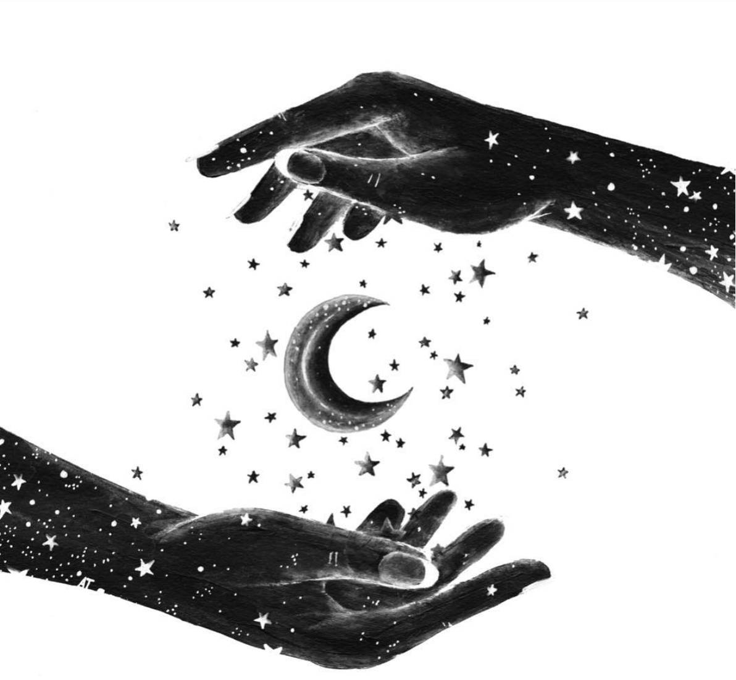
Creator vs Consumer: What Can You Create?
A new habit?
A website?
A business?
A bigger business?
An inviting space in your home?

Slide 14
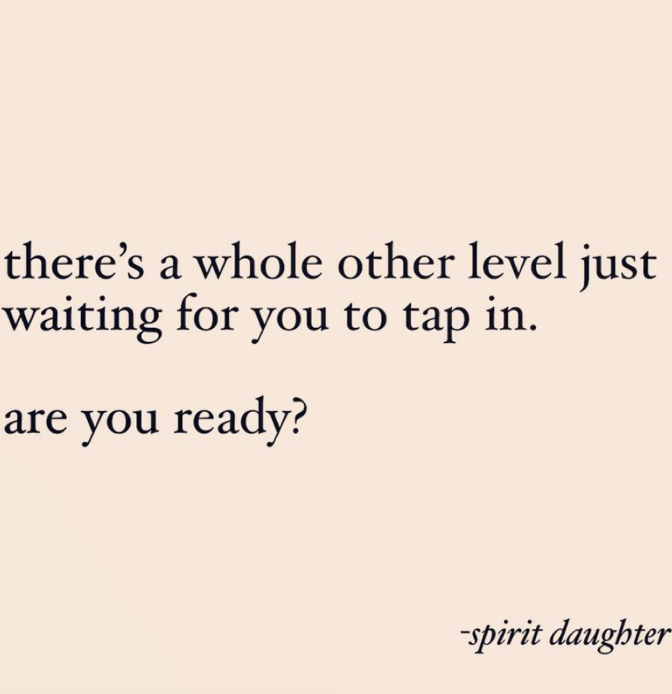
What do you want to manifest in 2019?
Write in the present tense
Let your mind run free
Write in “I am” statements
“I am a leader in the wellness industry. I am a yoga instructor and moon circle facilitator. I am hosting workshops and connecting with other beautiful, like-minded individuals. I am healthy, joyful, and have so much abundance in my life. I am beginning a beautiful, healthy, loving relationship with my new husband. I am inspiring others to see the best in themselves and fully step into who they have always been. I am raising the vibration of the earth to usher in this new era of consciousness.”

Slide 15
How can you add more joy to your life?
What did you love doing as a child?
Can you do more of those things this year?
When you live in a state of joy, life flows more beautifully
This year is all about creating what your soul yearns and spending time doing what brings you joy

Slide 16
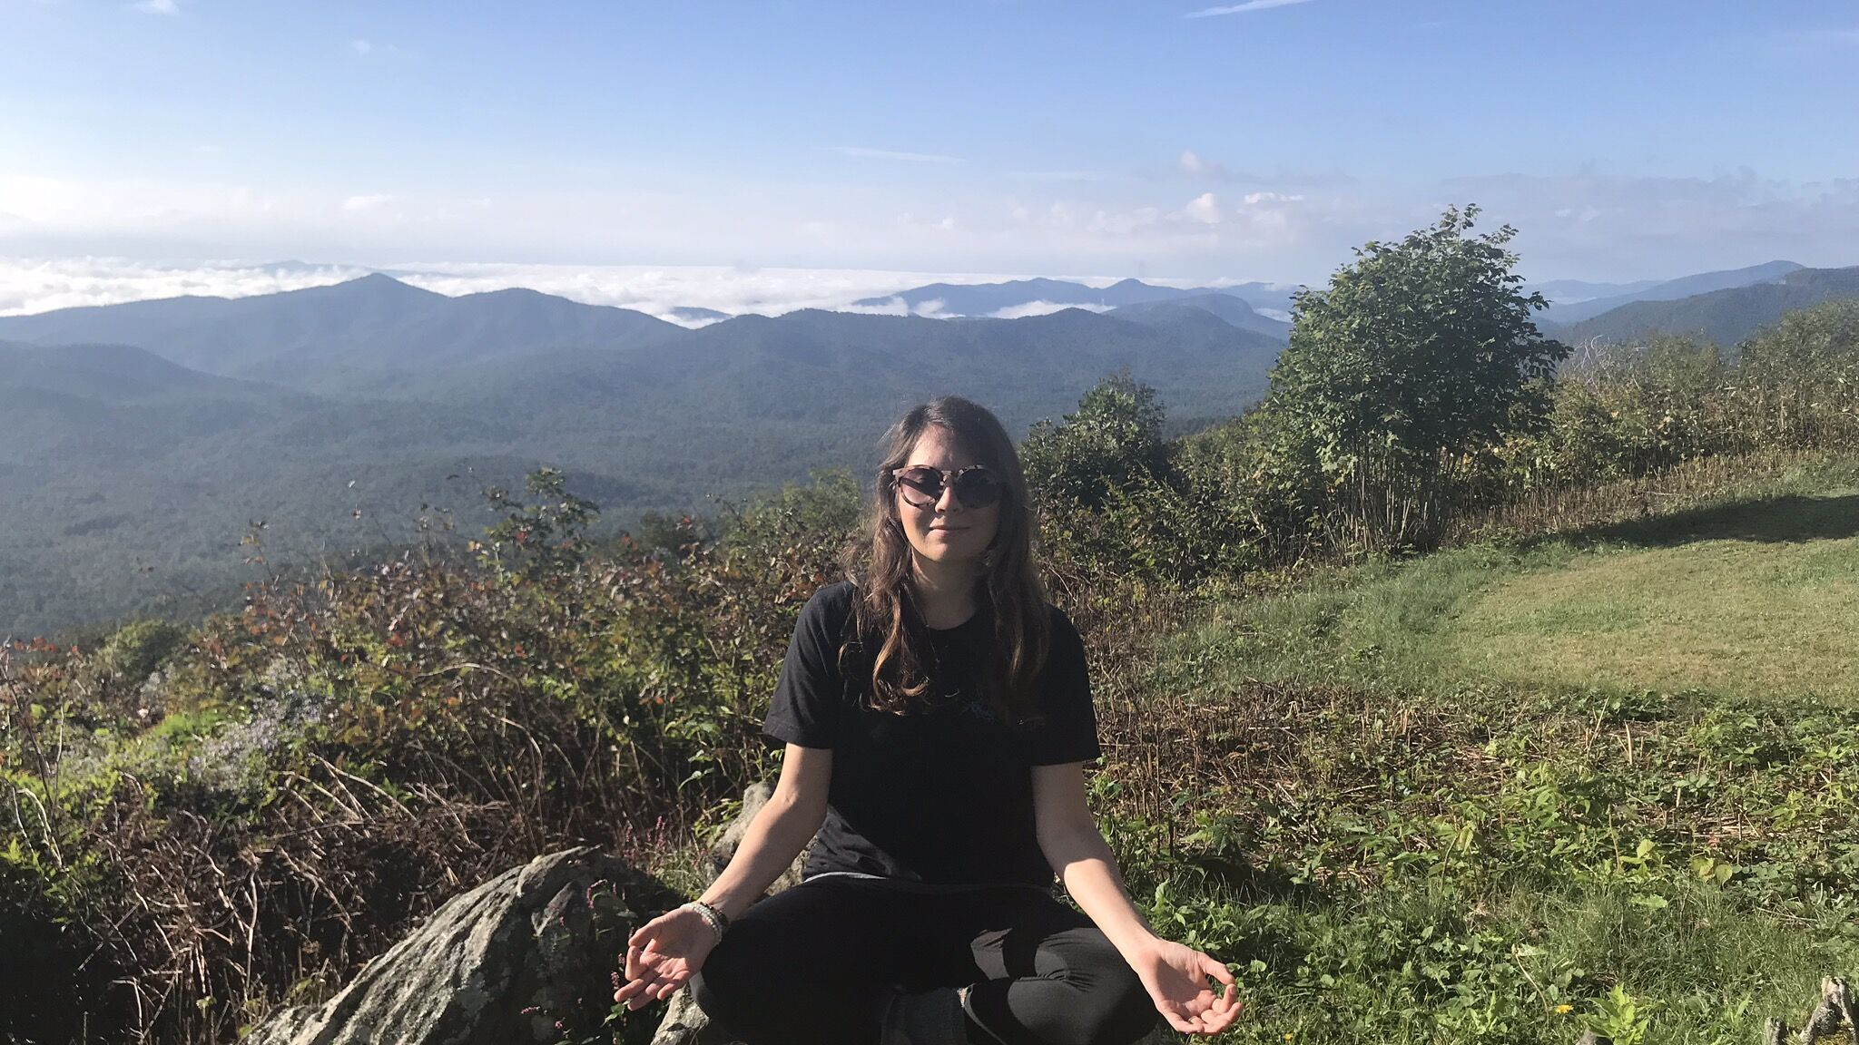
MEDITATION

Slide 17
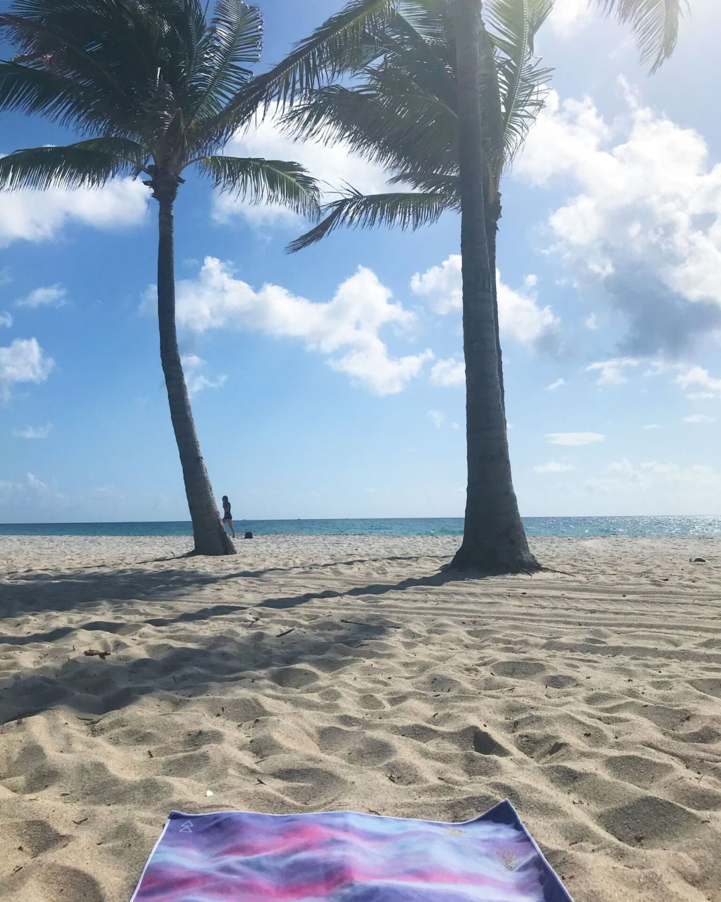
Meditation
So important to create space in your mind
Best ideas and clarity come from meditating, even a few moments a day
Reduces stress, controls anxiety
Enhances self awareness
And so much more

Slide 18
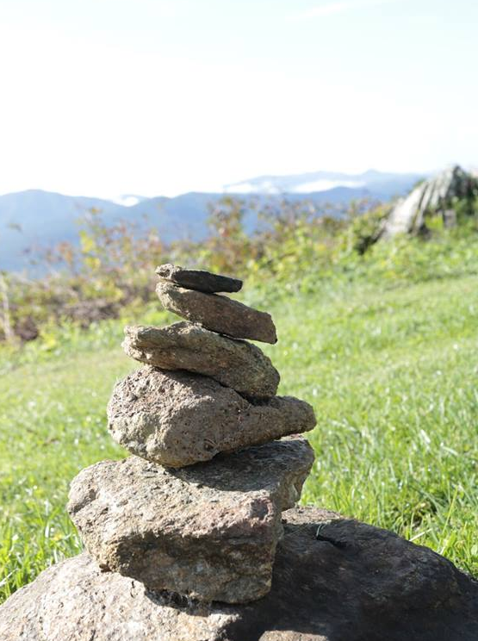
Meditation Tips
Create a time and place
Cleanse – sage or palo santo
Guided app or music (or silence)
Insight Timer
Focus on something
Attend a class
Rise Well Being Center
https://www.evergreensoles.com/2018/11/30/my-best-meditation-tips-for-beginners/

Slide 19
How to use the moon as a guide this year
New Moon: Time to set your intentions, a time to go within, rest, and dream
Full Moon: High energy, a time to release what is no longer serving you, and see your intentions come to fruition.
Each moon has it’s own unique energy and theme. You can work with this energy each month

Slide 20
Join me at a moon circle
Join me at an upcoming moon circle!
Honoring the cycles of the moon provides us an with opportunity to spend time in a circle with other women to breathe, stretch, meditate reflect, and set intentions for what we want to manifest in our lives, together.

Slide 22
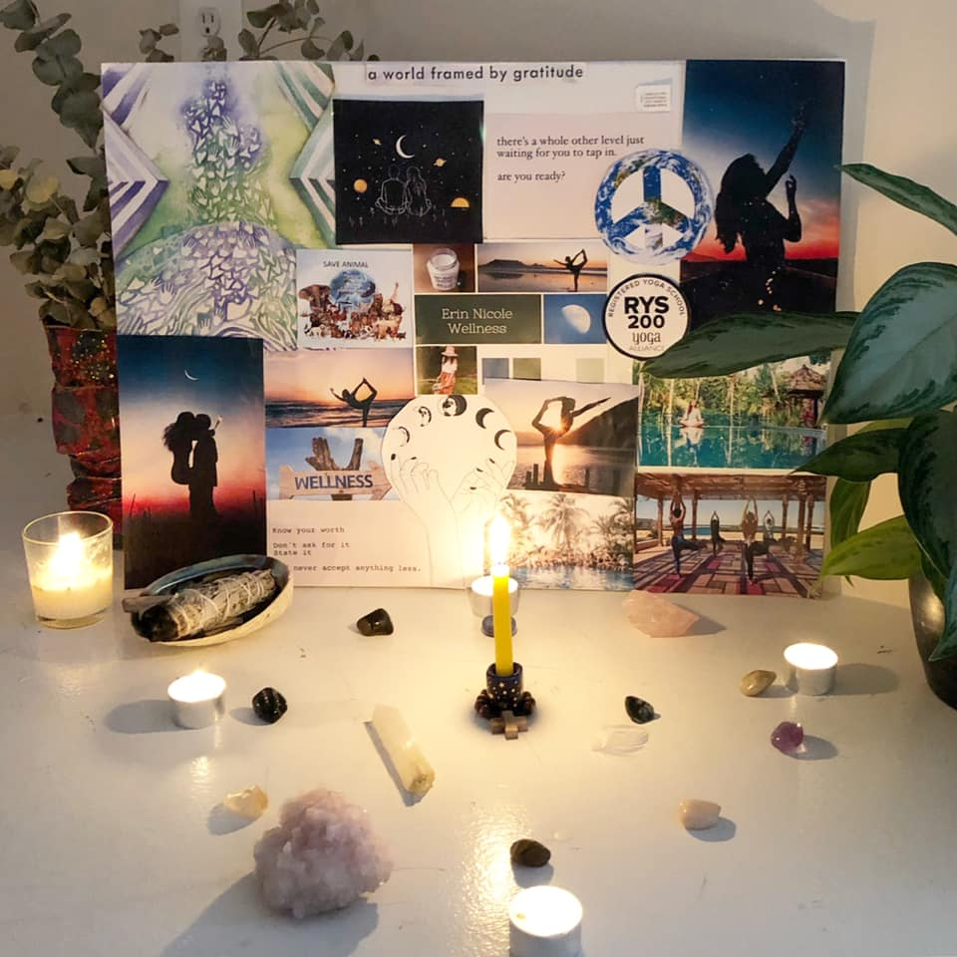
Tools to Make Your Dreams a Reality
Create a vision board - ”feed” it every day
Begin a daily meditation practice – see how your mind begins to expand and become clear
Tune in to the cycles of the moon – notice how your own energy waxes and wanes just as the cycles of the moon do too – especially as women. Use these natural timekeepers to keep track of your bite-size monthly intentions

Slide 23
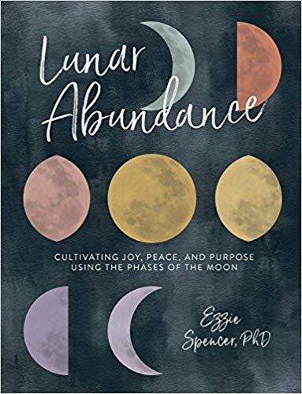
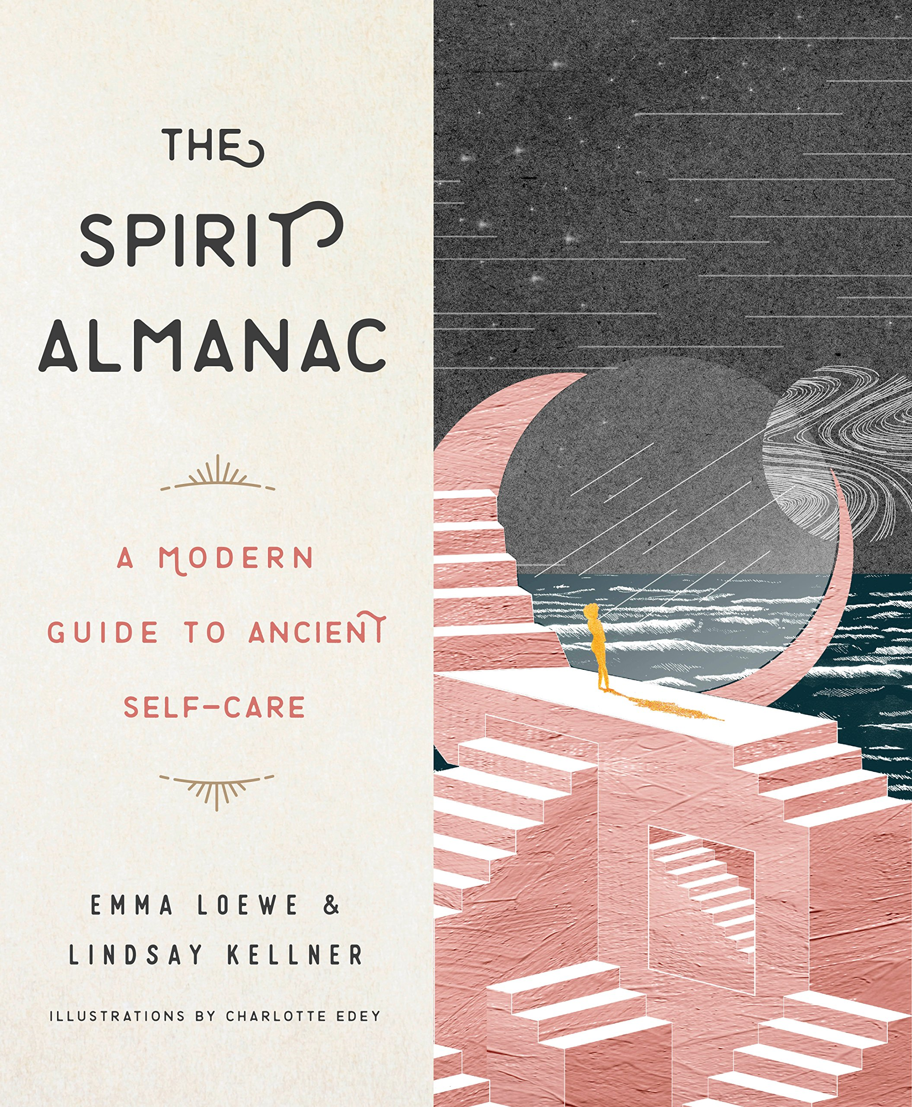
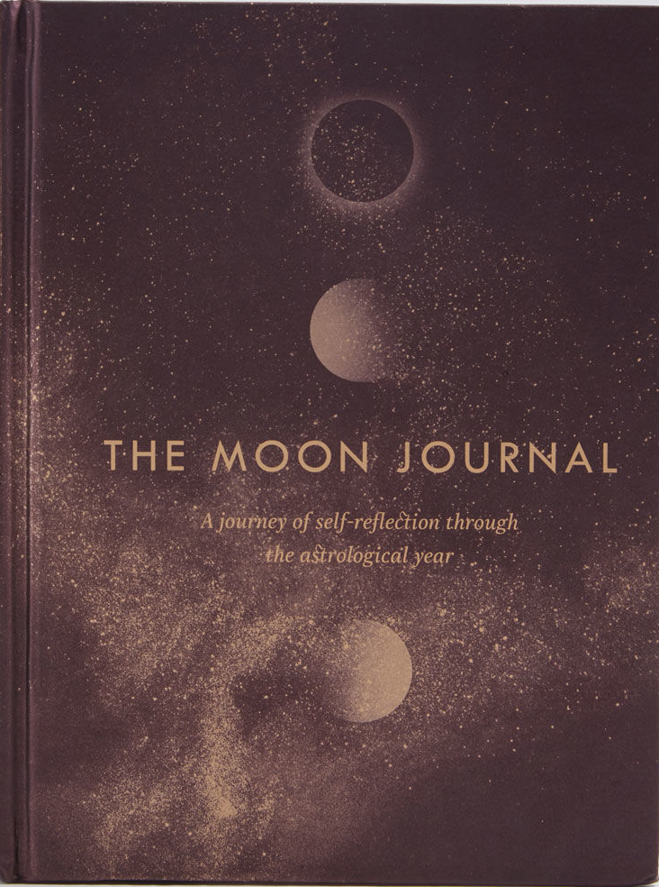
Some of my favorite books

Slide 24
